Slide 1

Predicting Student Performance Using Data Mining Techniques

Slide 2
Table of Contents
1
2
3
Introduction
Data Pre-Processing
Prediction Method
6
5
4
Limitations/Future Works
Discussion
Results

Slide 3
Introduction
Background Information
• Data includes student achievement in secondary education of two Portuguese schools
• Attributes: student grades, demographic, social and school related features
• Collected via school reports and questionnaires
Problem Description:
• Develop a classification model to analyze the relationship between students' achievements and other factors
Goal:
• Gain valuable insights on the students and provide that to teachers
• With this information they can then make data-driven decisions

Slide 4
Attributes
Variable Name | Type | Description
School | Categorical | Student's school
Sex | Binary | Student's sex
Age | Integer | Student's age
Address | Categorical | Student's home address type
Famsize | Categorical | Family size
Pstatus | Categorical | Parent's cohabitation status
Medu | Integer | Mother's education
Fedu | Integer | Father's education
Mjob | Categorical | Mother's job
Fjob | Categorical | Father's job
Reason | Categorical | Reason to choose this school

Slide 5
Attributes Cont.
Variable Name | Type | Description
Guardian | Categorical | Student's guardian
Traveltime | Integer | Home to school travel time
Studytime | Integer | Weekly study time
Failures | Integer | # of past class failures
Schoolsup | Binary | Extra educational support
Famsup | Binary | Family educational support
Paid | Binary | Extra paid classes w/in the course subject (Math or Portuguese)
Activities | Binary | Extra-curricular
Nursery | Binary | Attended nursery school
Higher | Binary | Take higher education
Internet | Binary | Internet access at home

Slide 6
Attributes Cont.
Variable Name | Type | Description
Romantic | Binary | With a romantic relationship
Famrel | Integer | Quality of family relationships
Freetime | Integer | Free time after school
Goout | Integer | Going out with friends
Dalc | Integer | Workday alcohol consumption
Walc | Integer | Weekend alcohol consumption
Health | Integer | Current health status
Absences | Integer | # of school absences
G1 | Categorical | First period grade (from 0 to 20)
G2 | Categorical | Second period grade (from 0 to 20)
G3 | Integer | Final grade (from 0 to 20, output target)

Slide 7
Data Pre-Processing

Slide 8
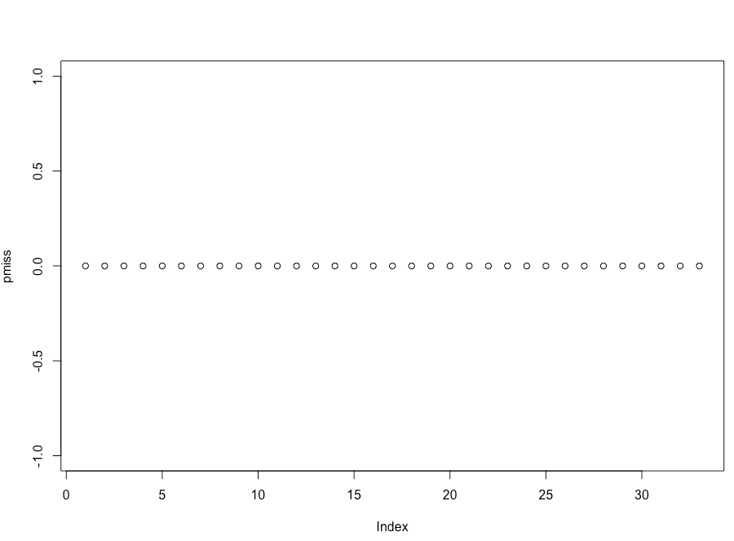
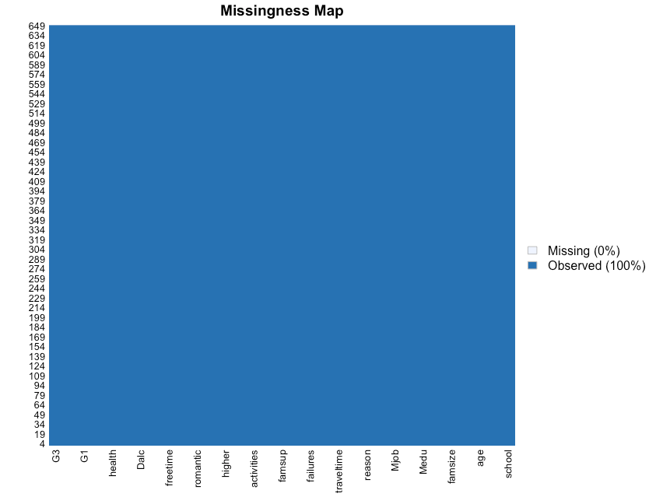
Data Pre-Processing: Check Missing Values
R Code:
# checking missing values
matrix.na = is.na(dat)
pmiss = colMeans(matrix.na) # proportion of missing for each column
nmiss = rowMeans(matrix.na) # proportion of missing for each row
plot(pmiss) # a few columns with high proportion of missing. we want to exclude them

Slide 9
Data Pre-Processing: Assigning Labels to Categorical Variables
R Code:
## Encoding Categorical variables
dat$school = factor(dat$school, level = c("GP", "MS"), labels = c(1,0) )
dat$sex = factor(dat$sex, level = c("M", "F"), labels = c(1,0) )
dat$address = factor(dat$address, level = c("U", "R"), labels = c(1,0) )
dat$famsize = factor(dat$famsize, level = c("GT3", "LE3"), labels = c(1,0) )
dat$Pstatus = factor(dat$Pstatus, level = c("T", "A"), labels = c(1,0) )
dat$Mjob = factor(dat$Mjob, level = c("at_home", "health", "teacher", "services", "other"), labels = c(0,1,2,3,4) )
dat$Fjob = factor(dat$Fjob, level = c("at_home", "health", "teacher", "services", "other"), labels = c(0,1,2,3,4) )
dat$reason = factor(dat$reason, level = c("home", "reputation", "course", "other"), labels = c(0,1,2,3) )
dat$guardian = factor(dat$guardian, level = c("mother", "father", "other"), labels = c(0,1,2) )
dat$schoolsup = factor(dat$schoolsup, level = c("yes", "no"), labels = c(1,0) )
dat$famsup = factor(dat$famsup, level = c("yes", "no"), labels = c(1,0) )
dat$paid = factor(dat$paid, level = c("yes", "no"), labels = c(1,0) )
dat$activities = factor(dat$activities, level = c("yes", "no"), labels = c(1,0) )
dat$nursery = factor(dat$nursery, level = c("yes", "no"), labels = c(1,0) )
dat$higher = factor(dat$higher, level = c("yes", "no"), labels = c(1,0) )
dat$internet = factor(dat$internet, level = c("yes", "no"), labels = c(1,0) )
dat$romantic = factor(dat$romantic, level = c("yes", "no"), labels = c(1,0) )

Slide 10
Data Pre-Processing: Converting Grades to Pass/Fail
Grades are transformed into a categorical variable representing pass or fail.
Conversion Criteria:
Threshold: Grades compared against a reference percentage of 60%.
Pass: Grades exceeding 60% labeled as "1".
Fail: Grades below 60% categorized as "0".
R Code:
dat$G1 <- ifelse(dat$G1 >= 12, 1, 0)​
dat$G2 <- ifelse(dat$G2 >= 12, 1, 0)​
dat$G3 <- ifelse(dat$G3 >= 12, 1, 0)​

Slide 11
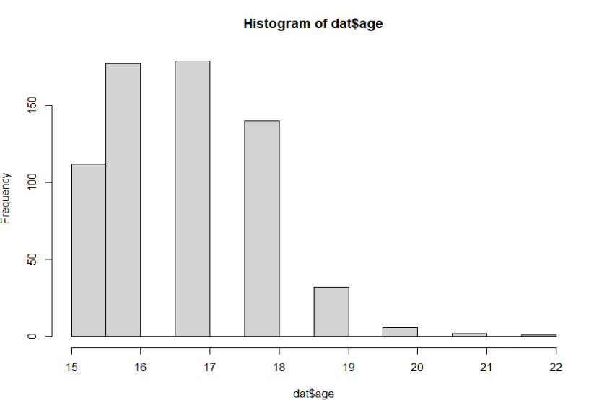
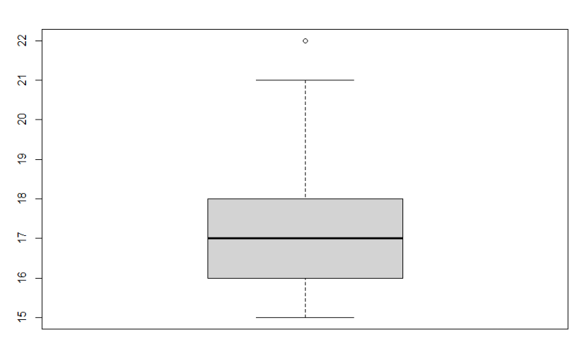
Data Pre-Processing: Continuous Variables
The code is designed to visually explore the distribution of continuous variables using a histogram and boxplot
R Code:
par(mfrow=c(1, 2))
hist(dat$age )
boxplot(dat$age )
#Boxplot identifies the potential outliers which may effect the analysis

Slide 12
Data Pre-Processing: Continuous Variables Cont.
Removing the outliers to clean the data.
These outliers which can potentially deviate the analysis.
The below example R script shows the variable "age" having the value(22) which need to be removed from the "age" column in data frame
R Code:
values_to_remove <- c(22)
dat <- dat[!dat$age %in% values_to_remove, ]

Slide 13
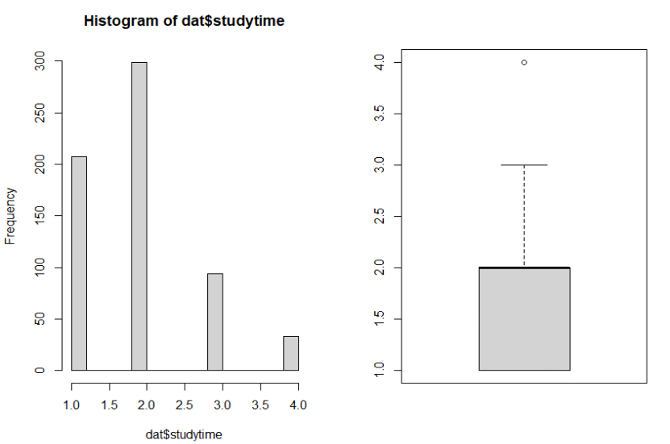
Data Pre-Processing: Continuous Variables Cont.
We are using histogram and boxplot to visualize the student study time where hours are assigned accordingly 1 - 0 to 2 hours, 2 - 2 to 5 hours, 3 – 5 to 10 hours, 4 – more than 10 hours.
R Code:
par(mfrow=c(1, 2))
hist(dat$studytime)
boxplot(dat$studytime)
values_to_remove <- c(4)
dat <- dat[!dat$studytime %in% values_to_remove, ]
boxplot(dat$studytime )

Slide 14
Data Pre-Processing: Continuous Variables Cont.
Similarly, checked the distribution of all continuous variables which are Walc, Dalc, health, goout etc.
Outliers have been identified and removed to obtain the clean data and accurate analysis.
In summary, this is a crucial step in data exploration which provides insights into data characteristics and guides the selection of appropriate statistical method.

Slide 15
Data Pre-Processing: Data Numerics
Verification conducted to ensure all variables are numeric for subsequent analysis.
Generated a dataframe exclusively comprising numeric variables.
Facilitates seamless analysis by ensuring uniform data format
R Code:
dat_numeric <- dat[sapply(dat, is.numeric)]
dat_numeric = subset(dat_numeric1, select = -c(G1, G2))

Slide 16
Data Pre-Processing: Zero Variance Variables
Identifying the zero variance variables.
Removing those variables from the data frame because they are not necessary for the analysis
R code:
zero_variance_vars <- names(dat_numeric)[apply(dat_numeric, 2, sd) == 0]
# Remove variables with zero variance
dat_numeric <- dat_numeric[, !names(dat_numeric) %in% zero_variance_vars]

Slide 17
Data Pre-Processing: Correlation Matrix
It quantifies the strength and direction of linear relationship between pairs of variable.
It identifies the multicollinearity between variables which can effect the reliability of statistical models
R code:
correlation_matrix <- cor(dat_numeric, method = "pearson")
# Print the correlation matrix
print(correlation_matrix)

Slide 18
Data Pre-Processing: Correlation Matrix Cont.
Identify highly correlated pairs with correlation coefficent greater than 0.8 or less than –0.8.
It helps in understanding redundant information of data and to decide whether to retain both variables or choose one for the analysis
R code:
highly_correlated_pairs <- which(abs(correlation_matrix) > 0.8 & correlation_matrix != 1, arr.ind = TRUE)​
print(highly_correlated_pairs)​

Slide 19
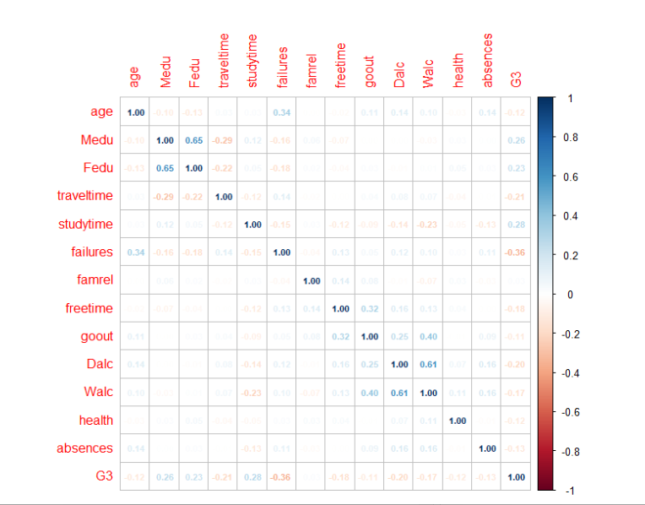
Data Pre-Processing: Correlation Matrix Cont.
Corrplot Visualization technique is used to represent the correlation matrices.
This makes it easier to interpreting complex relations and identify the pattern of the data.
R code:
library(corrplot)
corrplot(correlation_matrix, method = "number", number.cex = 0.7)

Slide 20
Data Pre-Processing: Correlation Matrix Cont.
Install "car" package in R which has functions of linear regression diagnostics called Variance inflation factor(VIF).
R code:
dat1 = subset(dat, select = c(G1, G2, G3))
install.packages("car")
library(car)
model <- lm(G3 ~ G1 + G2, data = dat1)
vif_values <- vif(model)
print(vif_values)
Result:
>model <- lm(G3 ~ G1 + G2, data = dat1) > > >vif_values <- vif(model) > >print(vif_values)
G1 G2
2.526845 2.526845

Slide 21
Data Pre-Processing: Categorical Variables
# check the frequency table of categorical variables and data is balanced or not
> table(dat$school)
1 0
375 181
> table(dat$sex)
1 0
234 322
> table(dat$address)
1 0
387 169
> table(dat$famsize)
1 0
397 159
> table(dat$Pstatus)
1 0
494 62
> table(dat$Mjob)
0 1 2 3 4
115 41 66 116 218
> table(dat$Fjob)
0 1 2 3 4
34 20 30 152 320

Slide 22
Data Pre-Processing: Categorical Variables Cont.
> table(dat$reason)
0 1 2 3
125 126 248 57
> table(dat$guardian)
0 1 2
389 132 35
> table(dat$schoolsup)
1 0
56 500 > table(dat$famsup)
1 0
344 212
> table(dat$paid)
1 0
32 524
> table(dat$activities)
1 0
284 272
> table(dat$nursery)
1 0
444 112
> table(dat$higher)
1 0
499 57
> table(dat$internet)
1 0
437 119
> table(dat$romantic)
1 0
208 348
> table(dat$G1)
0 1
284 272
> table(dat$G2)
0 1
276 280
> table(dat$G3)
0 1
250 306

Slide 23
Prediction Method - Logistic Regression

Slide 24
Logistic Regression
Logistic regression is used to model binary outcomes based on one or more predictor variables.
Application: In this case, predicting whether students pass (1) or fail (0) based on their characteristics and academic performance.
Stepwise Regression Techniques
1. Forward Selection: Starts with minimal model (only intercept). Adds predictors sequentially until no significant improvement in model fit.
2. Backward Elimination: Starts with maximal model (all predictors). Removes predictors sequentially until further removal worsens model fit. 3. Both-directional (Stepwise) Selection: Combines forward and backward methods. Iteratively adjusts by adding and removing predictors to optimize model fit.

Slide 25
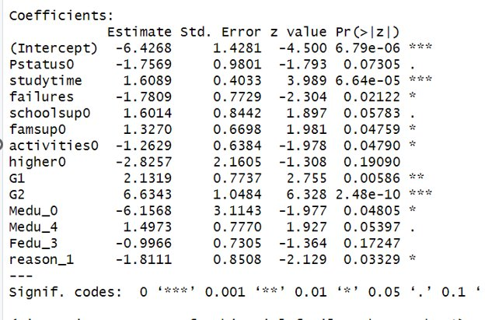
Logistic Regression
Evaluating Model Performance Confusion Matrix: Visualizes actual vs. predicted outcomes. Components: true positives, false positives, true negatives, and false negatives. Key Metrics: These metrics assess the accuracy of the model in identifying positive and negative outcomes, crucial for understanding model performance in different scenarios. Sensitivity: Proportion of actual positives correctly identified (True Positive Rate). Specificity: Proportion of actual negatives correctly identified (True Negative Rate).
Misclassification Error Rate: The proportion of total predictions that were incorrectly classified. Relevance: Provides a straightforward measure of the overall accuracy of the model, highlighting the importance of minimizing incorrect predictions. Significant Variables: Grades, study time, and past failures are significant variables that schools should focus on to predict and improve student success.

Slide 26
Logistic Regression Results
Logistic Regression ( With G1 and G2 included)
Cutoff | Metrics | Forward | Backward | Stepwise
Cutoff=0.5 | Val ER | 7.62% | 8.07% | 8.07%
 | Sensitivity | 92.91% | 93.70% | 93.70%
 | Specificity | 91.67% | 89.58% | 89.58%
Cutoff=0.4 | Val ER | 8.52% | 8.52% | 8.52%
 | Sensitivity | 92.91% | 93.70% | 93.70%
 | Specificity | 89.58% | 88.54% | 88.54%
Cutoff=0.3 | Val ER | 9.42% | 8.97% | 8.97%
 | Sensitivity | 93.70% | 93.70% | 93.70%
 | Specificity | 86.46% | 87.50% | 87.50%
 | Logistic Regression ( Without G1 and G2)
Cutoff | Metrics | Forward | Backward | Stepwise
Cutoff=0.5 | Val ER | 26.46% | 26.00% | 28.25%
 | Sensitivity | 83.46% | 94.49% | 95.26%
 | Specificity | 60.42% | 46.88% | 40.63%

Slide 27
Logistic Regression Results
Comparison and Analysis
The Forward selection model generally provides a slightly better balance between sensitivity and specificity at higher cutoffs (0.5), potentially making it the preferred model when aiming for balanced performance.
Lowering the cutoff generally leads to higher sensitivity but lower specificity and higher validation error rates, suggesting a trade-off between capturing more true positives and increasing the number of false positives.
Performance Drop: When G1 and G2 are excluded, there's a significant increase in the validation error rate and a notable decrease in specificity across all model selection methods. This indicates a substantial degradation in the model's ability to correctly classify students, particularly in terms of avoiding false positives.
Sensitivity Increase: Interestingly, sensitivity increases in the models without G1 and G2 for the Backward and Stepwise methods, suggesting these models are better at identifying true positives under these settings. However, this comes at the cost of greatly reduced specificity.
Conclusion : When predicting student performance, the inclusion of G1 and G2 grades leads to far superior model performance overall, as indicated by much lower validation error rates and higher specificity.

Slide 28
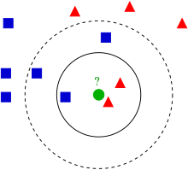
KNN (K-Nearest Neighbors) Analysis
For a given record to be classified, identify nearby records – each record consists of an outcome (class membership) and predictor values
Classify the record as whatever the predominant class is among the nearby records (the “neighbors”)

Slide 29
KNN (K-Nearest Neighbors) Analysis Cont.
Steps involved in implementing KNN for categorical outcome
1. Data preprocessing
2. Choosing the value of Best K (based on error rate/ prediction metrics)
3. Making predictions
4. Evaluating model performance

Slide 30
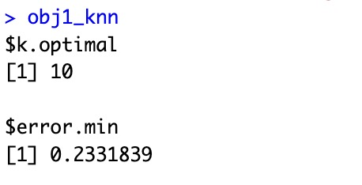
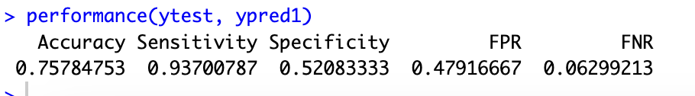
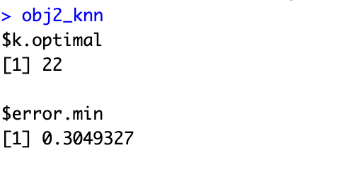
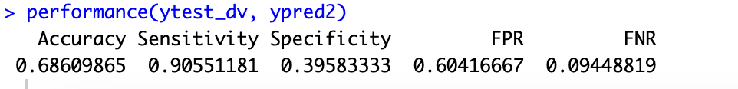
KNN Analysis Results
While considering all variables (G1 and G2 as categorical):
While excluding G1 and G2:

Slide 31
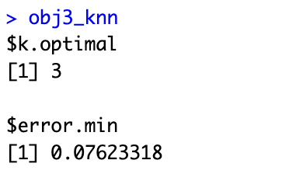
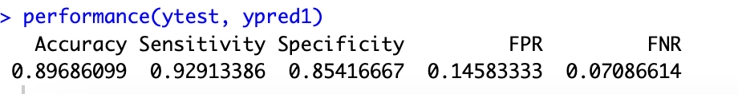
KNN Analysis Results
While considering only significant variables from Regression Model:
Significant variables : "studytime", "failures", "reason", "higher", "school", "traveltime", "schoolsup", "G1", "G2"

Slide 32
Final KNN Conclusion
After analyzing different combination of variables, we got the best performance metrics while considering significant variables from logistic regression.

Slide 33
CART (Classification and Regression Tree)
Classification Tree is a prediction modeling technique.
Classification tree is used for categorizing data based on input.
Each node represents a decision point.
Each branch represents a possible outcome or classification.
Notes:
CART also known as classifcation and regression tress
And if the target varibale consists of continous data we will have to perform regression trees
For our dataset we are profiming classificiotn tess becsuse out target varibale which is G3 is having distinct values.
So classification tree is a prediction modeling technique which is used to categorizing data based on input variables
In classification tree each node represents a decision piint
And each branch represents a possible outcome.

Slide 34
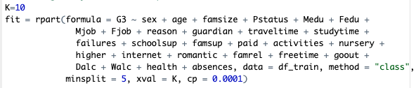
Parameters Included
minsplit : Minimum number of Observation in each Node.
xval : Number of Cross-Validation groups (k).
cp : Complexity Parameter which controls the Complexity of a tree.
Notes:
Parameters we included in this tree model are
minsplit , xval , cp
minsplit parameter is used to specify minimum no.of observations that must exist in a node to perform a split.
xval - parameter specifies the number of cross-validation groups k to be used during the training of the tree model.
cp – Complexity parameter is used to adjust the complexity of a tree,
Smaller cp values tend to result in more complex trees with lower bias but higher variance, while larger cp values lead to simpler trees with higher bias but lower variance.

Slide 35
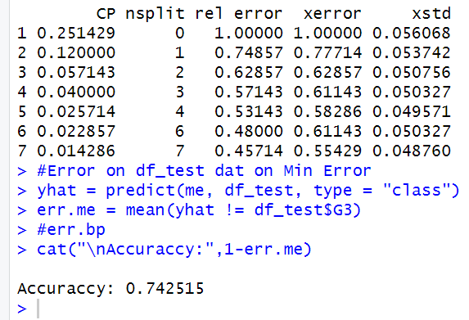
Finding CP (Minimum Error Tree)
Notes:
Initially we set cp to 0.0001 and for minimum error tree it ends at 0.14286 with 7 splits in the tree and accuracy of 0.742515

Slide 36
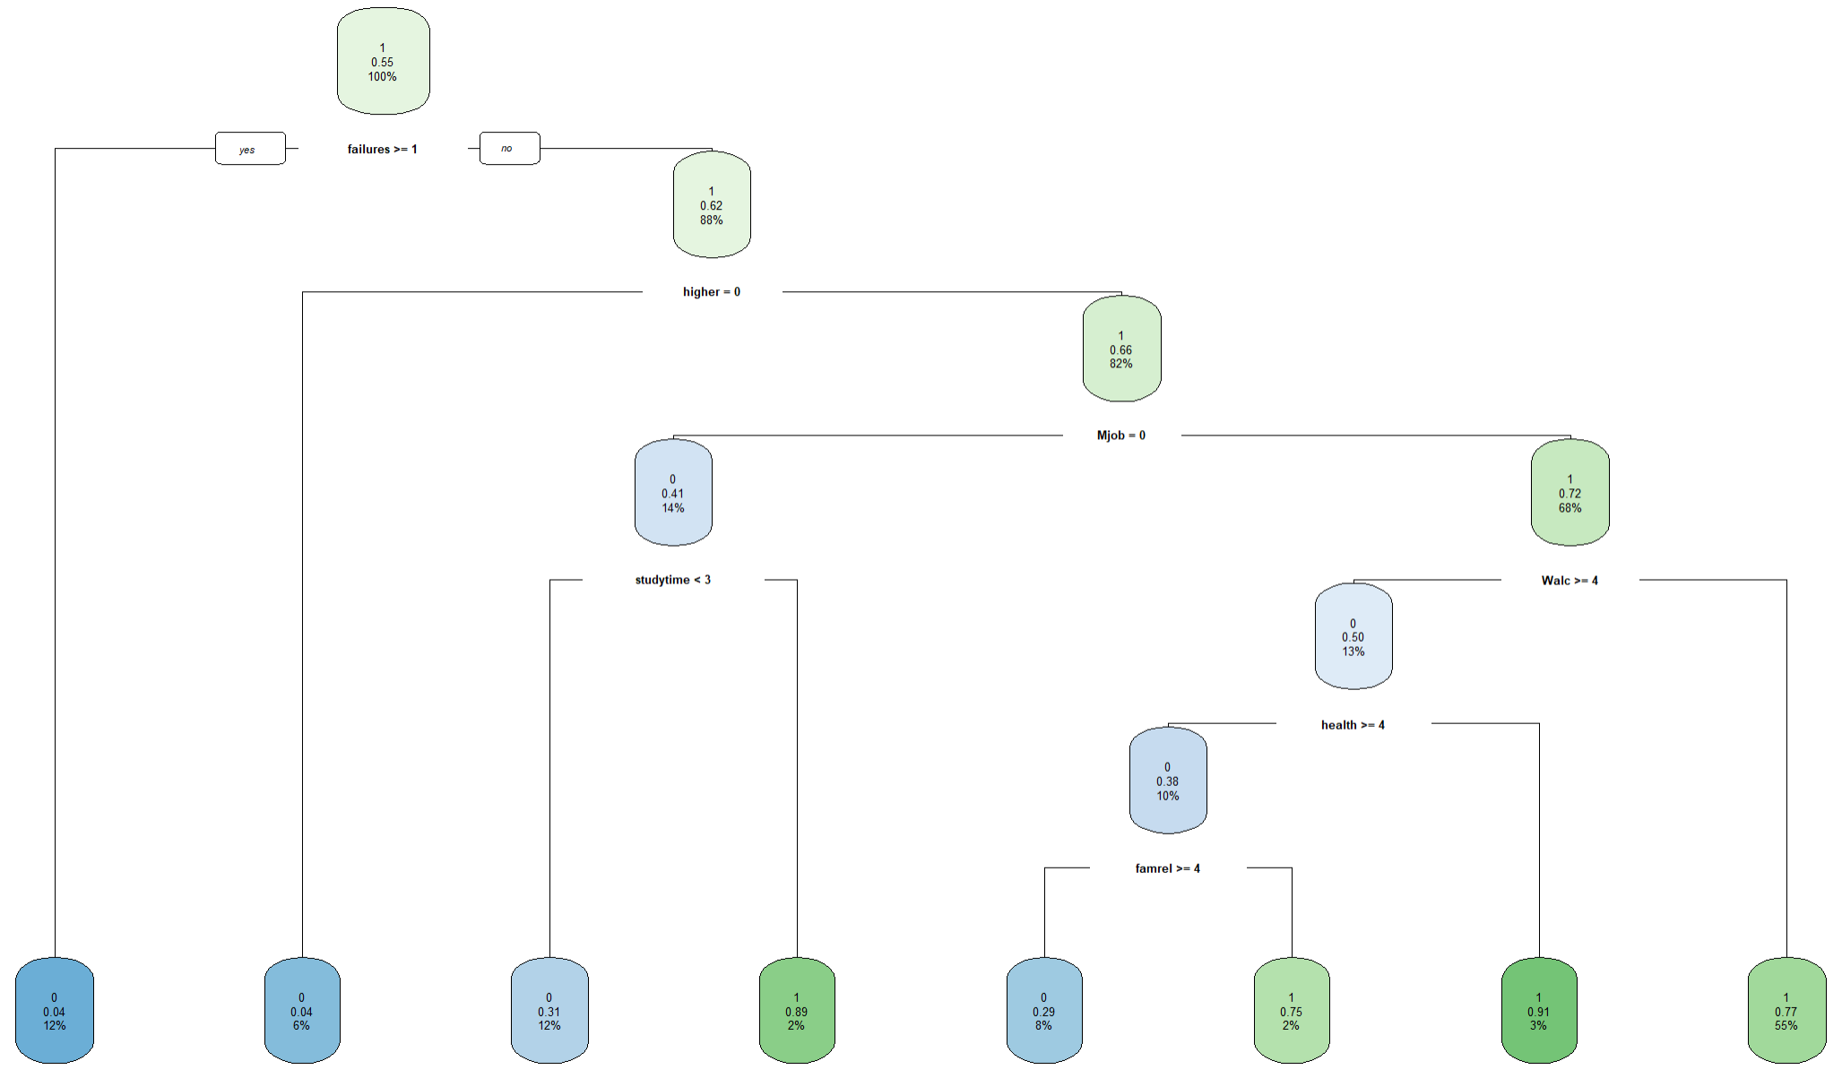

Minimum Error Tree
Splits included:
failures -- Past Class Failures
higher -- Higher Education
Mjob -- Mother's Job
studytime -- Weekly Study Time
Walc - Weekend Alcohol consumption
health -- Health Status
famrel -- Family Relationships
0.77 is the probability
55% of the data lies in this node
Notes:
This is the minimum error tree with 7 splits which includes
Failures, higher, Mjob, studytime, Walc, Health, famrel.
This is the tree and this is how you interpret a node in a tree
55% of the data lines in this node
The probability is 0.77

Slide 37
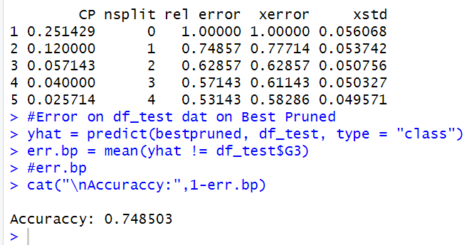
Finding CP (Best Pruned Tree)
Notes:
These are the cp values of best pruned tree which is basically simplifying the minimum error tree
As you can see there are only 4 splits with cp value 0.025714 and accuracy on 0.748503

Slide 38
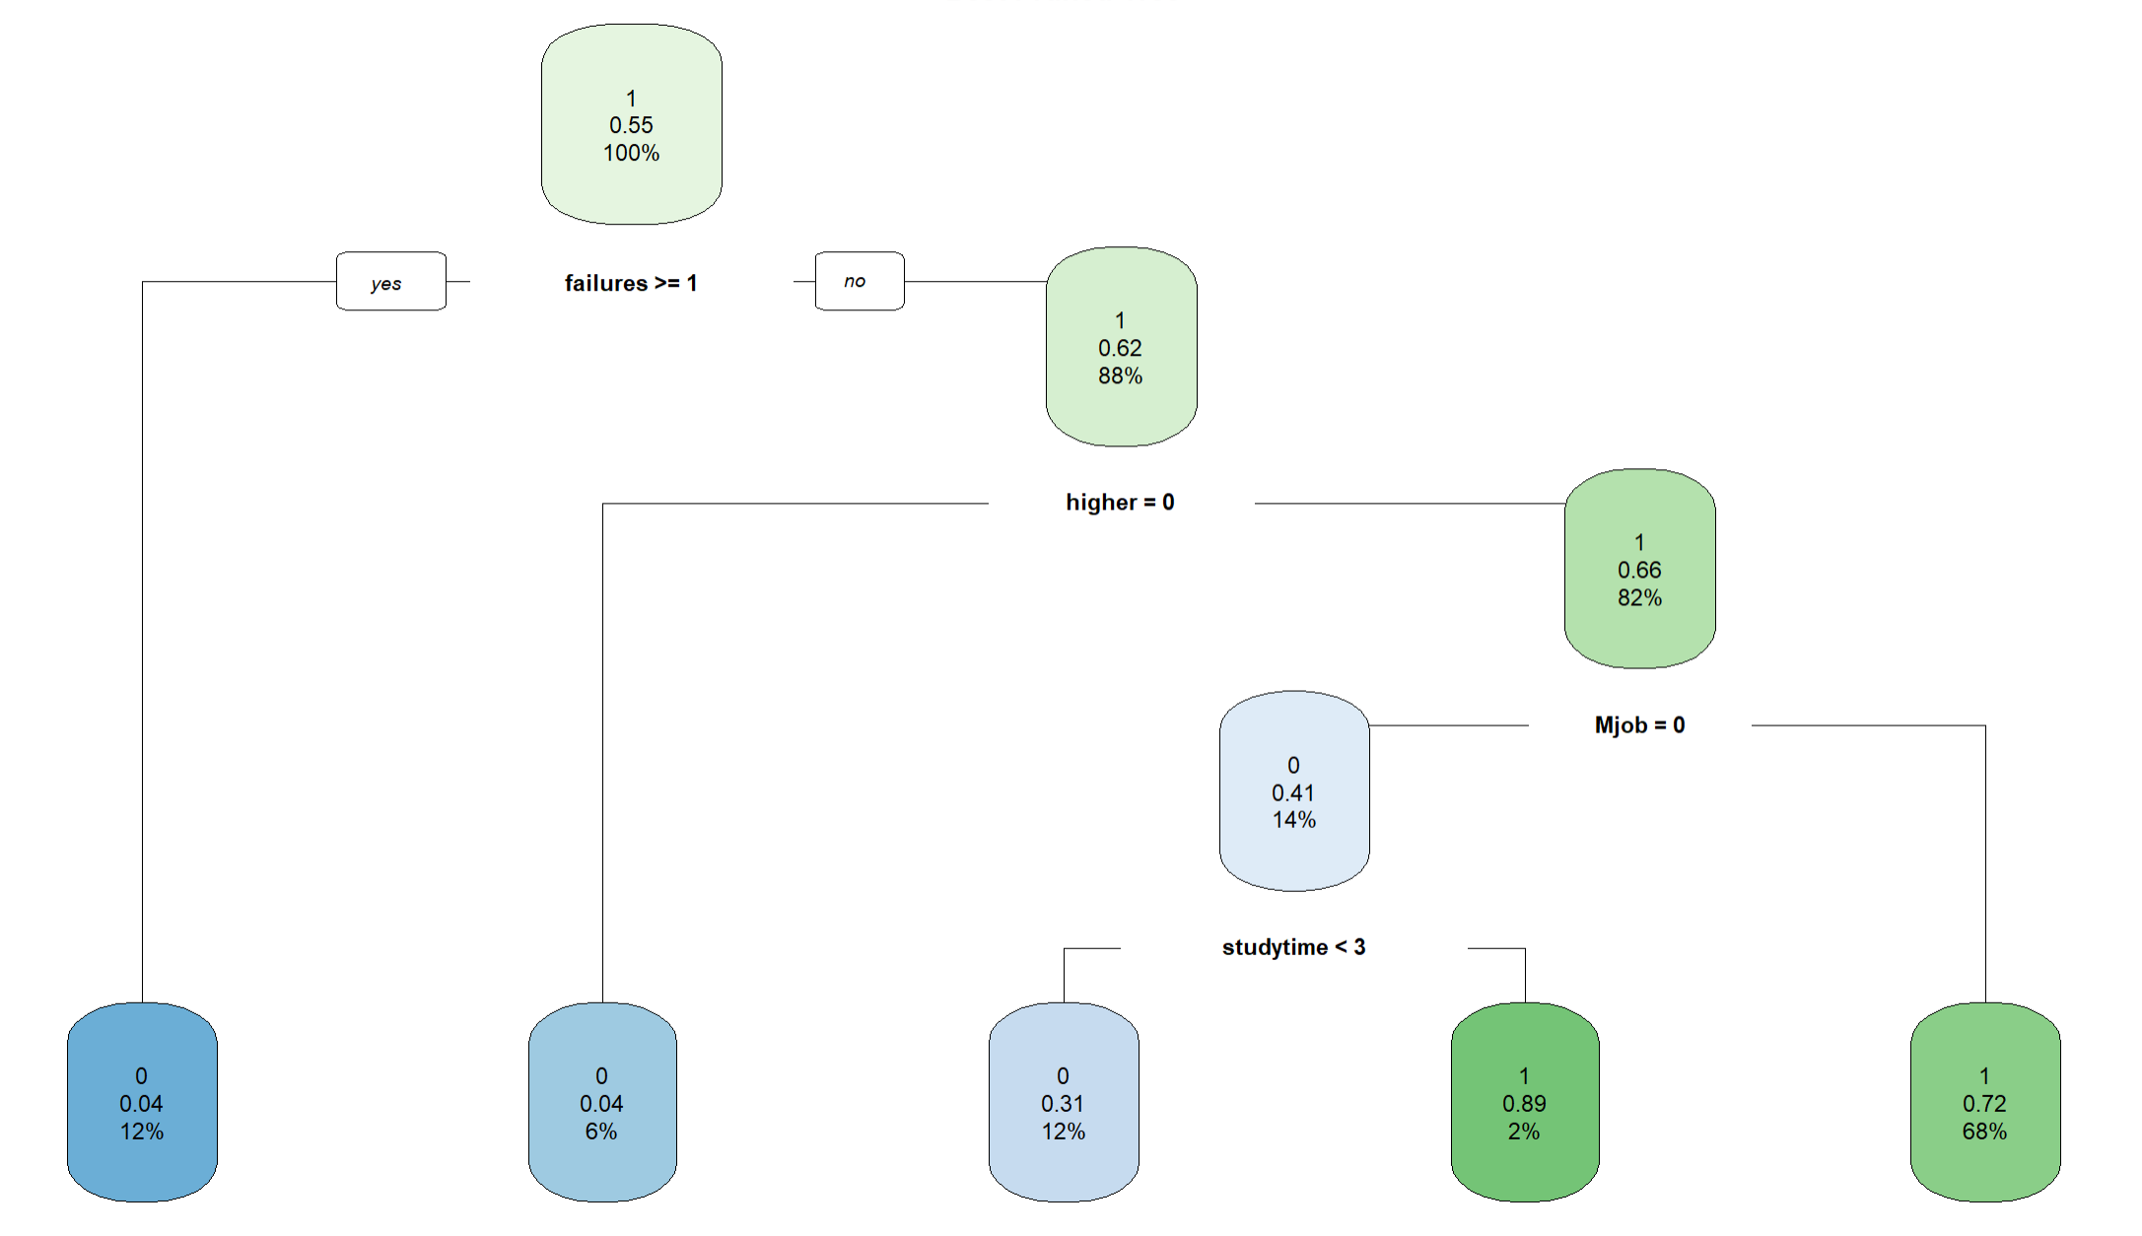
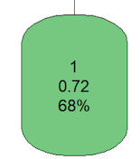
Best Pruned Tree
Splits Included
failures -- Past Class Failures
higher -- Higher Education
Mjob -- Mother's Job
studytime -- Weekly Study Time
Notes:
This is the best pruned tree with only 5 splits which includes
Failures, higer, Mjob, studytime.

Slide 39
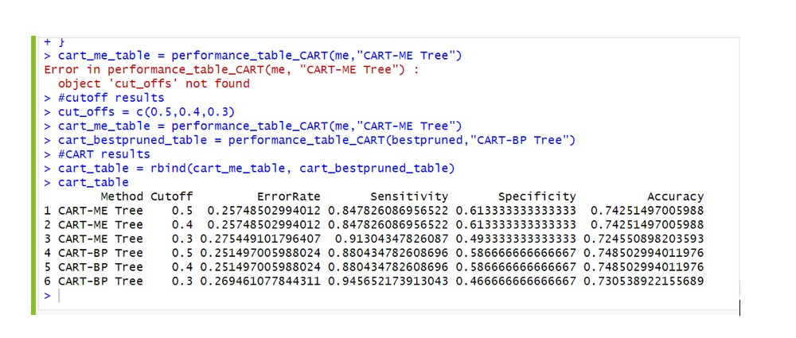
CART Results
The accuracy is higher when Cutoff values are (0.5, 0.4)
Minimum error tree – 0.74
Best pruned tree – 0.75
Notes:
These are the results with cutoffs 0.5, 0.4, 0.3

Slide 40
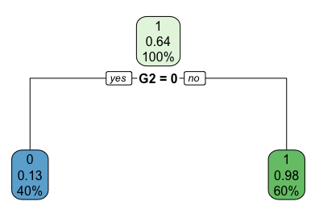
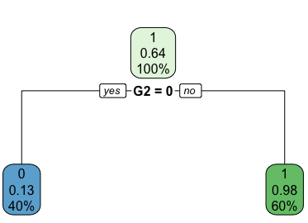
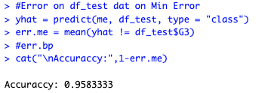
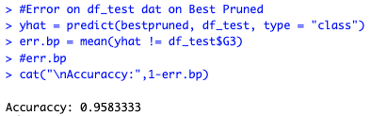
CART Including G1 & G2
Minimum Error Tree
Best Pruned Tree

Slide 41
Discussion & Limitations and Future Works

Slide 42
Discussion
What We Learned:
Methodological Excellence: "We meticulously applied three advanced machine learning models—KNN, CART, and Logistic Regression—to not only predict outcomes but also interpret the underlying factors driving student success."
Model Insights: "Detailed comparison of model outputs revealed that Logistic Regression excels in predictive reliability and interpretability, while CART offers deep insights into non-linear relationships and KNN uncovers local patterns and anomalies."
Significant Predictors Uncovered: "We identified several non-traditional predictors of student success, including psychological well-being and extracurricular engagement, alongside traditional metrics like grades and family background."
Data Integrity Solutions: "We tackled complex challenges such as missing values and dataset skewness with sophisticated imputation models and adaptive resampling methods, ensuring robustness in our findings."

Slide 43

Discussion Cont.
Models including G1 and G2 grades predicted final performance with an accuracy of over 90%, compared to just 70% when these grades were excluded.
Variables like study habits and parental education emerged as significant, explaining up to 15% of the variance in student performance on their own.

Slide 44
Result Comparison
Logistic Regression |  |  |  |  | KNN | Classification Tree
Cutoff | Metrics | Forward | Backward | Stepwise |  | Minimum | Best Pruned
Cutoff=0.5 | Val ER | 7.62% | 8.07% | 8.07% | 7.62% | 25.75% | 25.15%
 | Sensitivity | 92.91% | 93.70% | 93.70% | 92.91% | 84.78% | 88.04%
 | Specificity | 91.67% | 89.58% | 89.58% | 85.42% | 61.33% | 58.66%
 | Accuracy | 92.38 | 91.93 | 91.93% | 89.69% | 74.25% | 74.85%
Cutoff=0.4 | Val ER | 8.52% | 8.52% | 8.52% | 10.31% | 25.74% | 25.15%
 | Sensitivity | 92.91% | 93.70% | 93.70% | 92.91% | 84.78% | 88.04%
 | Specificity | 89.58% | 88.54% | 88.54% | 90.63% | 61.33% | 58.66%
 | Accuracy | 91.48% | 91.48% | 91.48% | 91.93% | 74.25% | 74.85%
Cutoff=0.3 | Val ER | 9.42% | 8.97% | 8.97% | 10.76% | 27.54% | 26.95%
 | Sensitivity | 93.70% | 93.70% | 93.70% | 92.92% | 91.30% | 94.56%
 | Specificity | 86.46% | 87.50% | 87.50% | 90.62% | 49.33% | 46.67%
 | Accuracy | 90.58 | 91.03 | 91.03% | 91.93% | 72.45% | 73.05%

Slide 45
Comparison with Prior Research Cont.
1. Comparative Baseline: Previous Studies
Zhang et al.
Method: Ensemble Models
Accuracy: 85%
Eleyan et al.
Method: Logistic Regression
Focus: Basic model implementation
3. Key Improvements
Increased Accuracy
Outperforms Zhang et al. by integrating diverse models
Robustness and Lower Error Rates
Improvements over Cortez & Silva's findings through refined preprocessing techniques
2. Our Approach
Integrated Multiple Models
Enhanced prediction sensitivity by approximately 5%
Advanced Data Preprocessing
Addressed robustness issues
Reduced error rates by 2-3%
4. Implications
Improved model reliability and accuracy in predicting student performance
Potential for application in educational tools and interventions

Slide 46
Implications and Applications
Theoretical Implications:
Validates and extends existing theories in educational data mining by incorporating modern machine learning techniques
Enhances understanding of which student behaviors and external factors correlate strongly with academic success
Practical Applications for Schools:
Schools can use these models to identify students at risk early, enabling timely interventions.
Insights from the study can help tailor student support programs based on predicted needs.
Policy Implications:
Our findings can inform policy by advocating for the integration of more comprehensive data analysis in educational strategy planning, ensuring resources are optimally allocated to address the diverse needs of students."
Real-World Utilization:
Beyond education, the modeling techniques can be adapted for use in other sectors like HR for employee performance prediction and retention strategies.
Potential for these analytics to inform governmental social programs targeting youth engagement and success.

Slide 47
Implications and Applications Cont.
“Identifying key factors influencing student success using predictive analytics.”
Key Insight: “Analysis shows students studying less than three hours per week are more likely to fail.”
Model Application: “Utilizing predictive models, we can proactively identify students at high risk of underperformance.”
Strategy Proposal: “Propose the initiation of custom-tailored support programs focused on these students, such as personalized tutoring sessions, study skills workshops, and time management training.”
Expected Impact: “Targeted interventions aim to improve academic outcomes, enhancing student engagement and reducing the likelihood of failure.”

Slide 48

Limitations & Future Works
Limited Sociocultural Context:
Data collected only from a Single Country i.e Portugal.
Replicate study across diverse Countries for generalizability.
Expanding Feature Set for Enhanced Classifier Accuracy:
Collect more cases to deepen understanding.
Explore additional attributes impacting student performance.

Slide 49

Limitations & Future Works Cont.
Enhanced Outlier Detection and Evaluation:
Consider alternative outlier detection methods for improved classification.
Utilize additional evaluation indicators:
Precision
Recall
Accuracy
False Positive Rate
False Negative Rate

Slide 50

Limitations & Future Works Cont.
Potential for Online Learning Environment:
Current study based on offline learning. Data was collected manually using reports and questionnaires
Future Opportunity for online learning:
Implement real-time student data and automated prediction engine within the school management system.

Slide 51
Thank You! Questions?

